Slide 1
How Quantum Storytelling Relates to Savall's Socioeconomic Dialectics, Spirals, and Multiplicities?
David M. Boje
Quantum Storytelling Conference
December, 2017

Slide 2
Answer
Spirals are built into SEAM model since 1975 book by Savall
Savall & Zardet (Hidden Costs book) has a dialectical approach
And Qualimetrics, Tetranormalization, and Socially Responsible Capitalism books have a Multiplicity approach
This includes (1) Numeric Multiplicity; (2) Qualitative Multiplicity; & (3) Mix of both

Slide 3
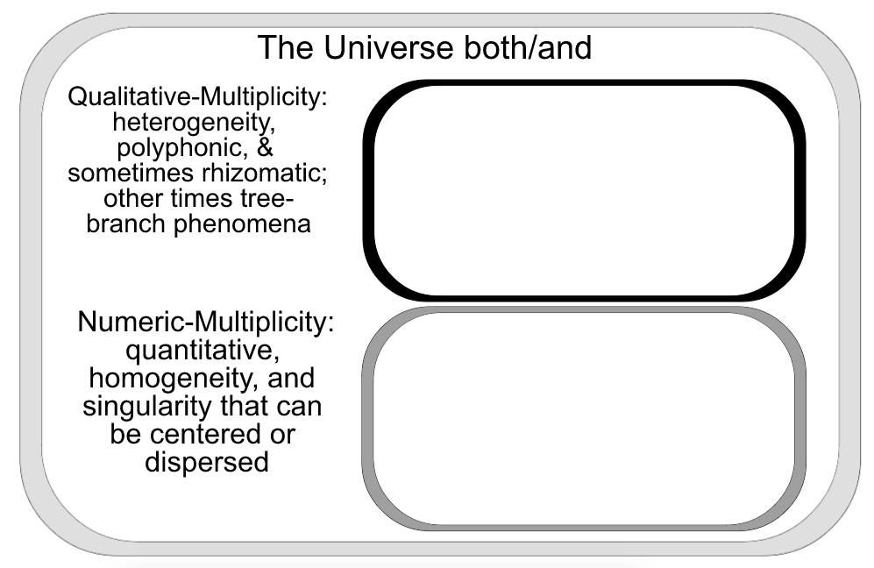

Slide 4
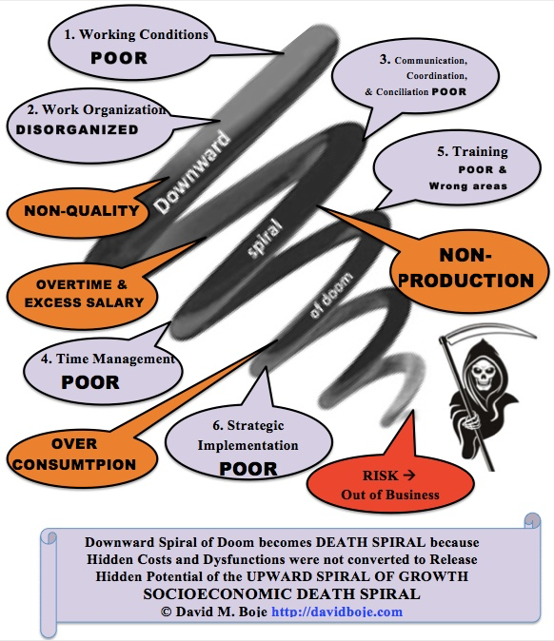

Slide 5
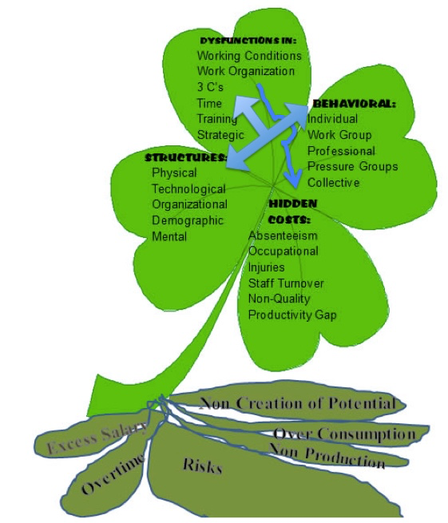
SEAM DIAGNOSTIC
4-Leaf Clover

Slide 6
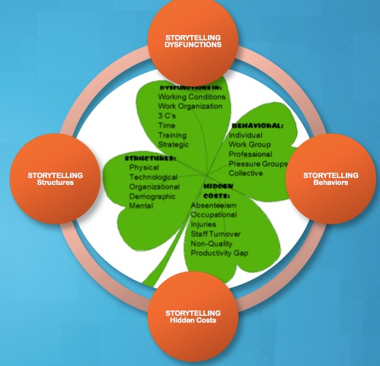

Slide 7
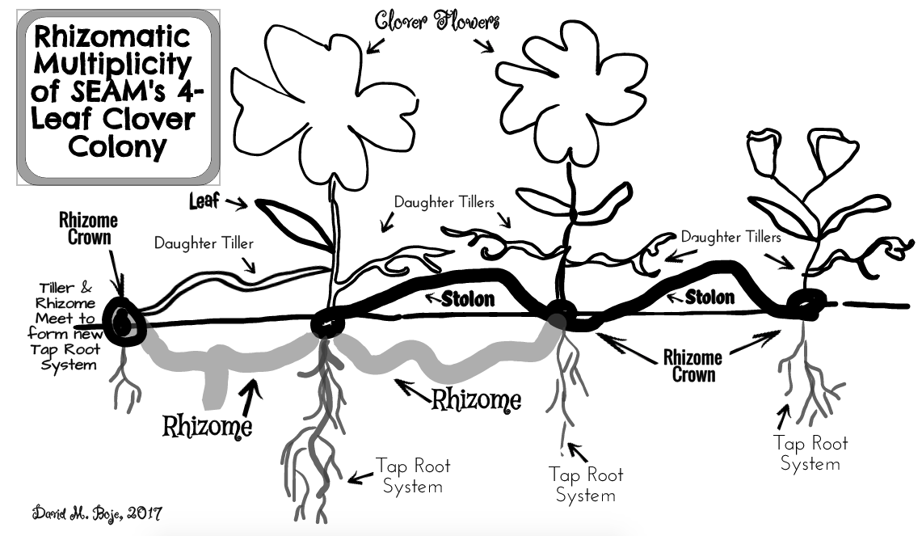

Slide 8
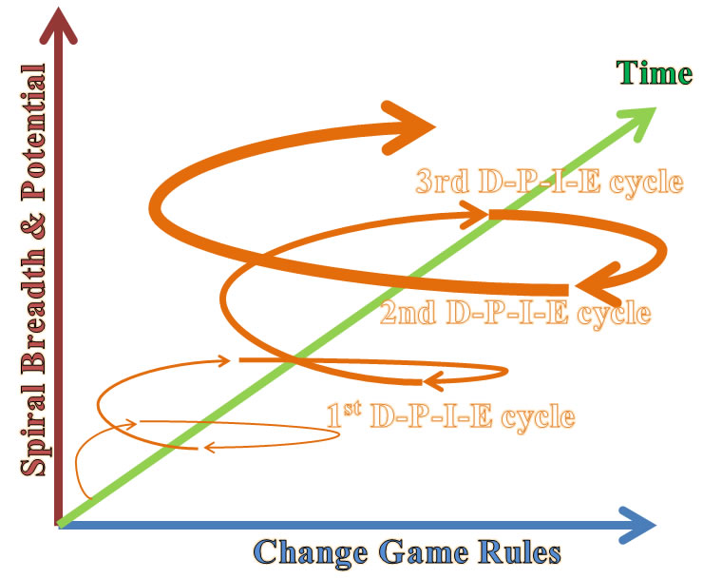

Slide 9
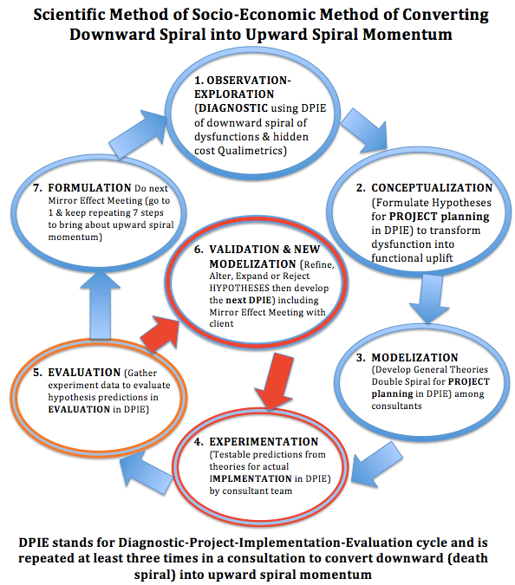
Based upon (Savall & Zardet, 2008: 145, 148) Thank you Rohny

Slide 10
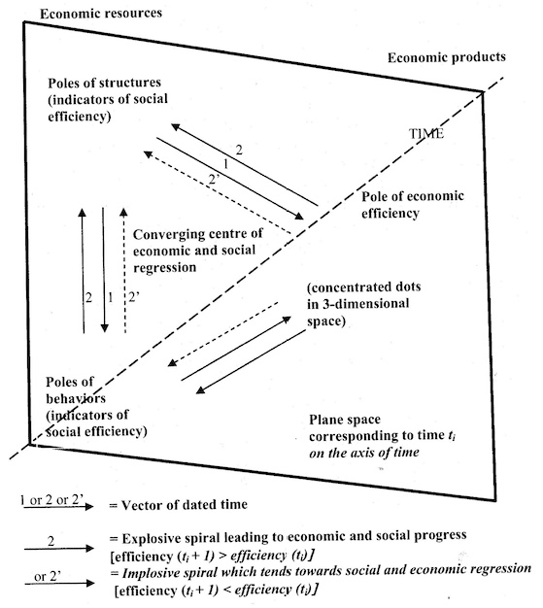
(Savall, 1975/2010: 205)
There is an important, and non-researched, double spiral that is theorized by Savall (1975/2010) which is dialectical relation between and explosive (upward) spiral and an implosive (downward) regressive {death} spiral

Slide 12
TRILECTIC
This is a positive dialectics, similar to Follettian dialectic, that is the interplay of practical findings from application with academic canons in a “conflict-cooperation dialectical system” to sort a zone of convergence (Savall & Zardet, 2008: 80).
Savall and Zardet (2008: 21) cite Peirce’s (1955) logics of induction, deduction, and abduction, but prefers to move from abductive hypothesis selections from many possible ones, to deduction, and finally inductive reasoning.

Slide 13
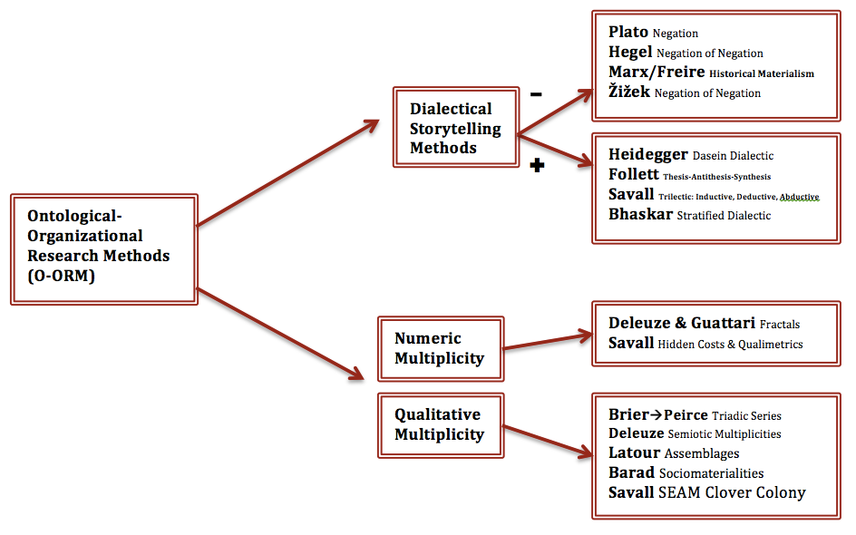
Thank you Mabel
Notes:
Thank you Mabel

Slide 14
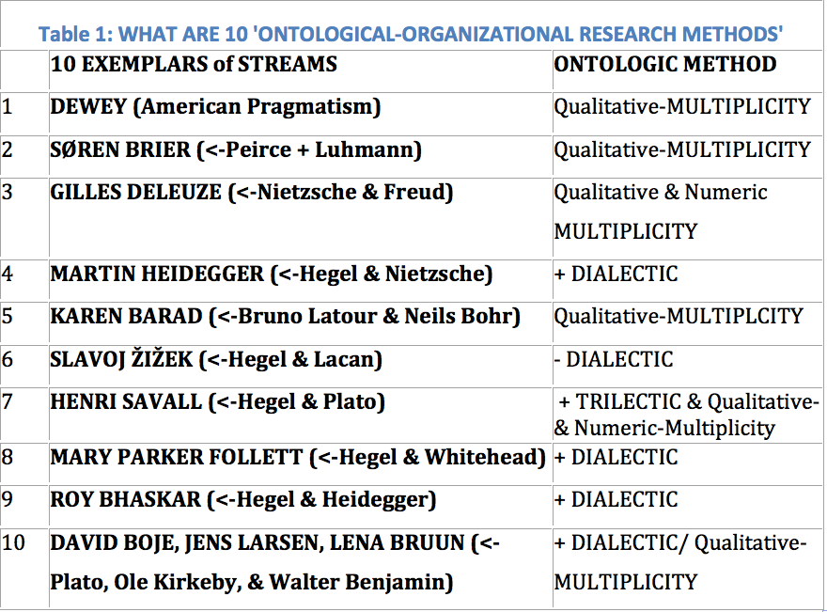

Slide 15
CONSTRUCT VALIDITY: Does (little x->y) measure adequately tap (Big X->Y) deductive theory? The Copernican Revolution in Construct Validity changes all remaining kinds of validity, and gives science a new storytelling of the empirical world.

Slide 16
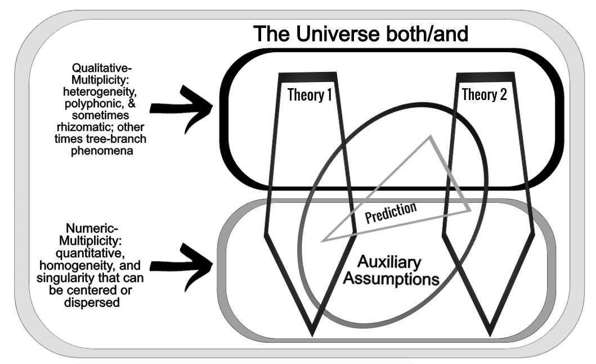

Slide 17
THANK YOU
Organizational Research Methods:
Storytelling In Action
David M. Boje
Book is due March 2018 to Routledge Publishers
http://davidboje.com/quantum

